Slide 1



Department of Computer Science & Engineering
Multimodal Document Intelligence System for Invoice and Receipt Processing Using Vision-Language Models with Layout-Aware OCR
Presented by
Sriganth.G.V
Jayasimbu.J
Aadhiseshan.S
Remo.V
Guided By
Dr.P.Nandhini
HOD/CSE

Slide 2
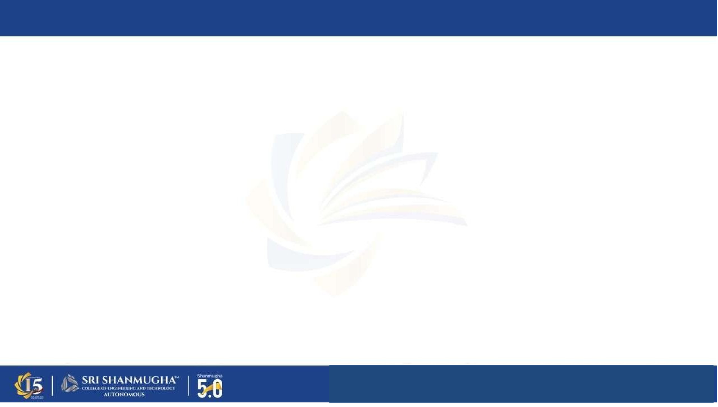
ABSTRACT
The proposed system is a Multimodal Document Intelligence Platform with Distributed Hardware Offloading. designed to automate invoice and receipt processing using advanced AI models. It Combines Qwen2.5-VL (32B) Visual Reasoning with local CLAHE image enhancement. to extract structured information such as vendor details, total amount, tax, and line items from scanned documents, handwritten receipts, and photographed bills. The system Generates a 'Digital Twin' layout grid while supporting 10+ Indic languages including Tamil and Hindi. and improves accuracy by understanding both the visual layout and textual content of documents, enabling efficient and intelligent data extraction for enterprise use.

Slide 3
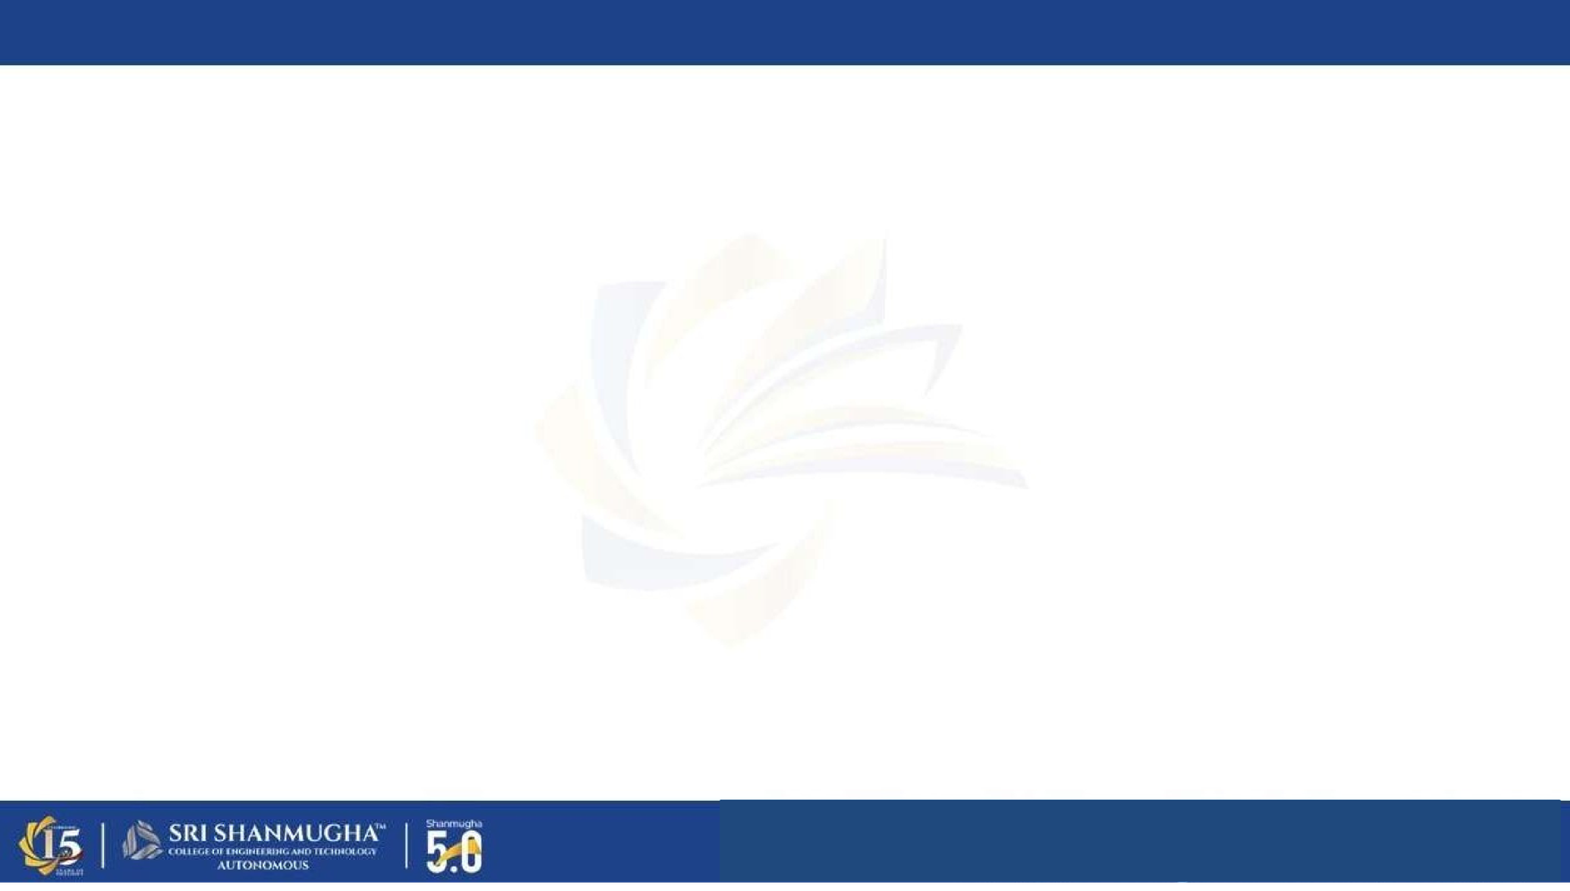
INTRODUCTION
In today’s digital era, businesses handle a large number of invoices and receipts in various formvlm such as scanned copies, images, and handwritten documents. Traditional data entry methods are time-consuming and error-prone. This project develops a multimodal document intelligence system that combines Qwen2.5-VL visual reasoning and layout-aware extraction to automatically process financial data with high accuracy.
Invoices and receipts are fundamental to business transactions, yet their manual processing is highly inefficient.

Slide 4
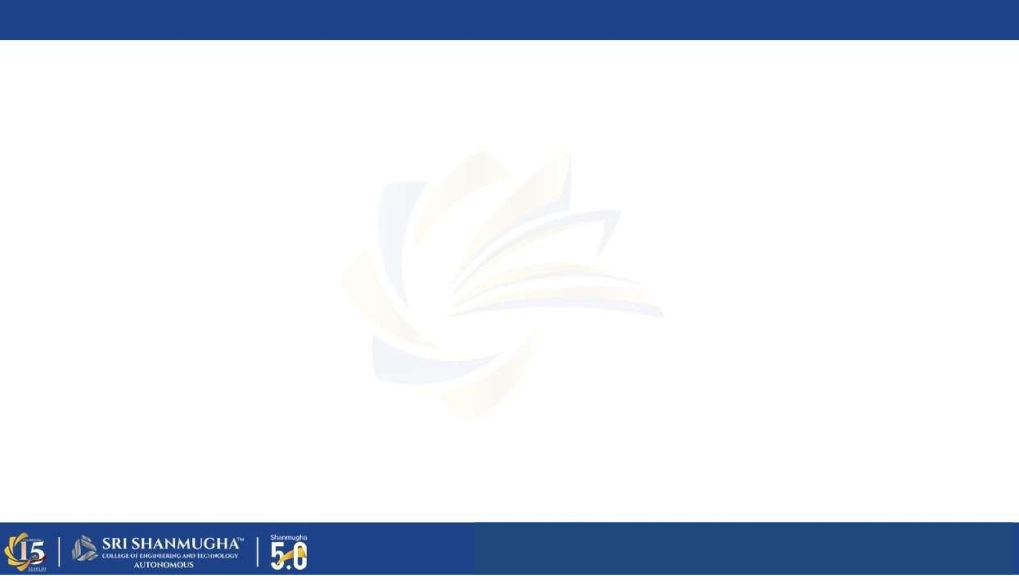
PROBLEM STATEMENT
Current invoice processing systems rely heavily on manual data entry or basic OCR techniques that only extract text without understanding the document layout or context. These systems struggle with complex formvlm, handwritten content, and multilingual documents. As a result, errors increase and processing time becomes high. Additionally, there is no proper system to extract structured information like line items and tax details accurately, leading to inefficiency in enterprise workflows.

Slide 5
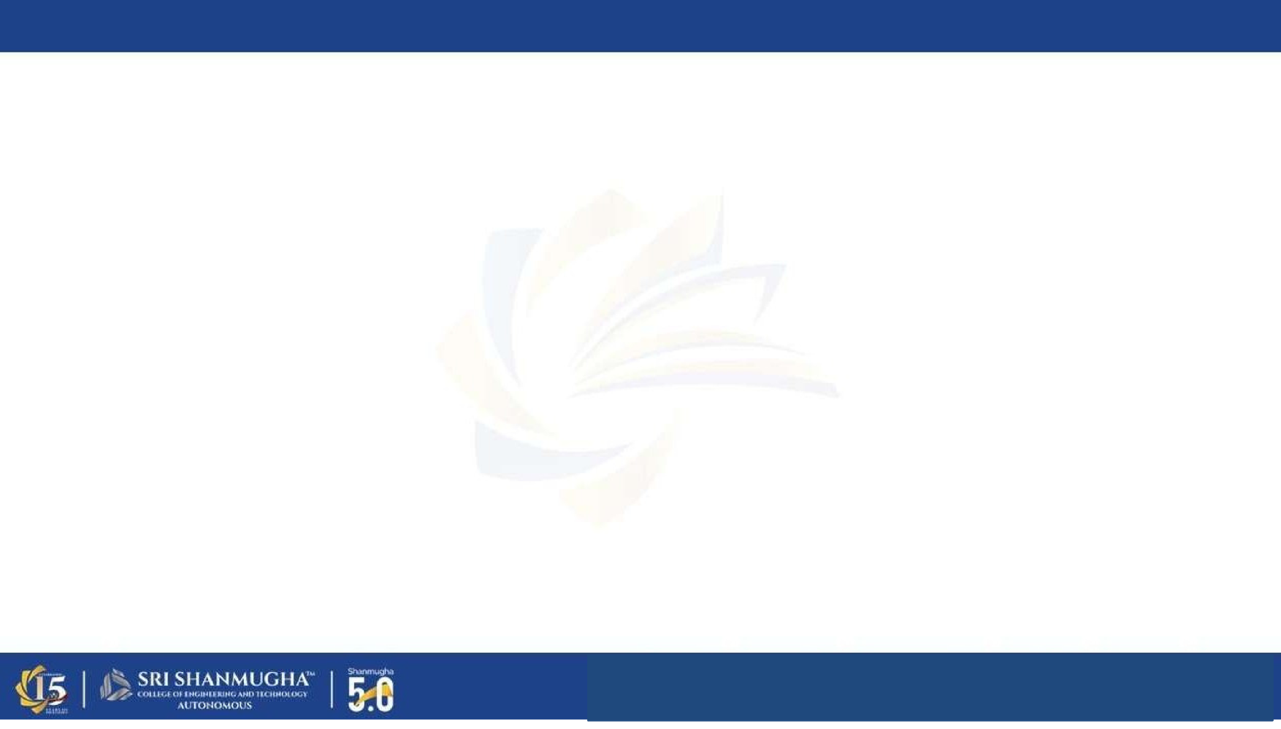
TOOLS USED
Frontend: React.js, JavaScript
Backend: FastAPI (Python-based API framework)
Vision Logic: CLAHE Enhancement & Naive Dynamic Resolution for structured storage
Backend: FastAPI Master Node (Local 4GB VRAM)
AI Models: Qwen2.5-VL-32B (GGUF), MiniCPM-V 2.6 (Hugging Face)
Infrastructure: Kaggle Dual-T4 GPU Worker + Cloudflare Tunnel

Slide 6


SYSTEM ARCHITECTURE
User Dashboard: React.js UI for uploading and viewing 'Digital Twin' layout results.: Provides user interface for uploading images through camera or file input, displays extracted results in dashboard, and communicates with backend using FastAPI for processing and data exchange.
Local Pre-processing: Applies CLAHE for thermal receipts and handles Dynamic Segment Splitting. to process input images and extract textual content along with bounding box coordinates, which helps in identifying the position of each text element in the document.
Remote Worker: Securely tunnels payload to Kaggle Dual-T4 GPUs for high-precision 32B-parameter VLM inference.: Takes OCR output as input and analyzes the document layout by understanding the spatial structure, relationships, and positioning of text elements to identify meaningful sections.
Visual Reasoning & Stitching: Qwen2.5-VL performs spatial extraction, and the backend stitches split segments into a final JSON.: Uses both image and extracted text to understand context and semantics, and accurately extracts structured information such as vendor name, total amount, tax details, and line items.

Slide 7
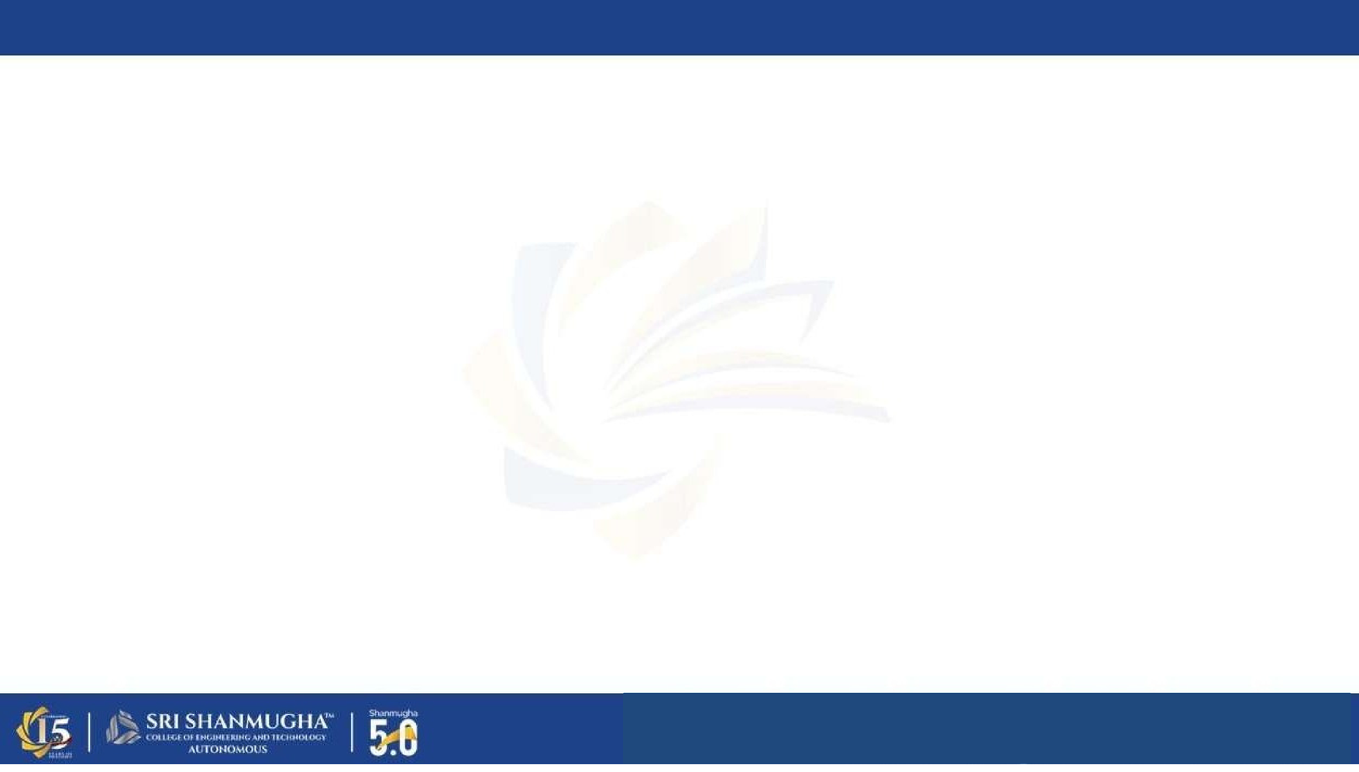
EXISTING SYSTEM
Existing systems mainly use basic OCR techniques that extract only raw text without understanding document structure. These systems fail to handle complex invoice layouts, handwritten text, and multilingual content effectively. Most solutions require manual verification and correction, making the process slow and inefficient.
Problems in Existing System:
Cannot understand document layout properly
Poor accuracy in handwritten and multilingual data
Requires manual data correction
Does not extract structured fields effectively

Slide 8
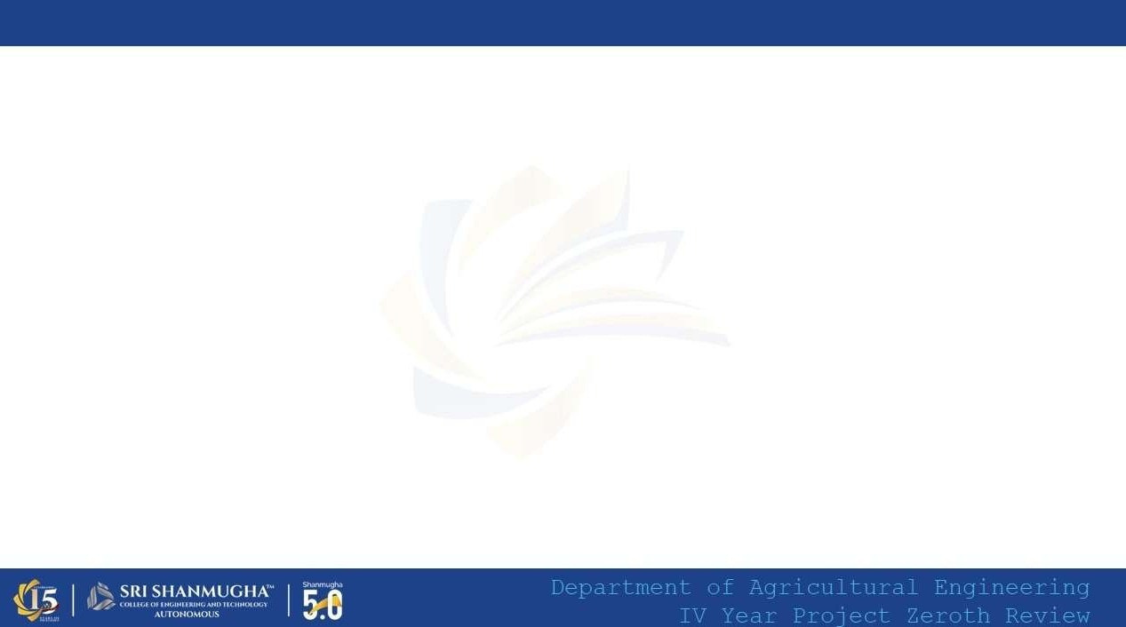

PROPOSE SYSTEM
A Distributed Multimodal Intelligence solution that bridges local hardware with cloud GPU acceleration. document processing solution that integrates layout-aware OCR with vision-language models to extract structured information from invoices and receipts. Uses 'Digital Twin' technology to preserve the spatial hierarchy of line items, taxes, and vendor details. and textual meaning of documents, enabling accurate extraction of key fields such as vendor details, amounts, and line items. Features language-aware prompts for 10+ Indic scripts and handles handwritten thermal receipts with CLAHE pre-processing. inputs, providing a fully automated and efficient solution for enterprise document processing.

Slide 9
ADVANTAGES
Provides accurate structured data extraction from invoices and receipts
Supports handwritten and multilingual document processing
Reduces manual data entry and human errors
Understands document layout and context effectively
Improves processing speed and automation
Suitable for real-time enterprise applications

Slide 10
THANK YOU

